Slide 1
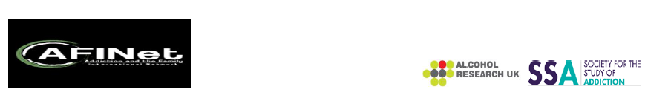

What Do Affected Families Want?
Running alone in the labyrinth or counting on a wraparound support network?
Daniela Capitanucci
AND-Azzardo e Nuove Dipendenze
(Italy)

Slide 2
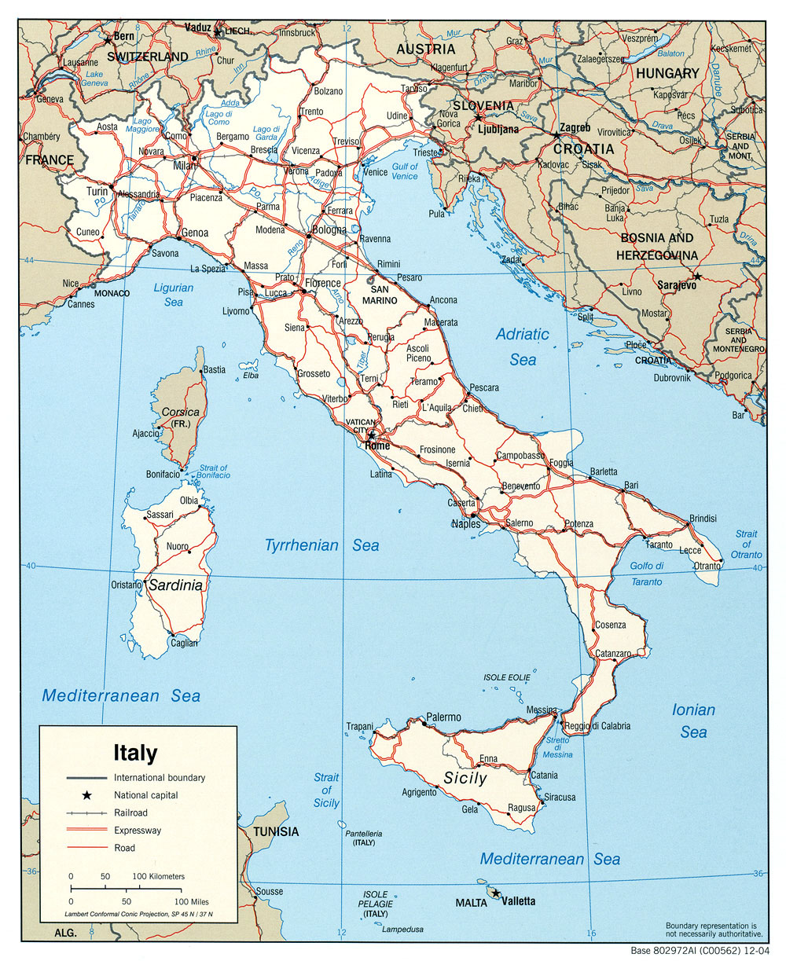
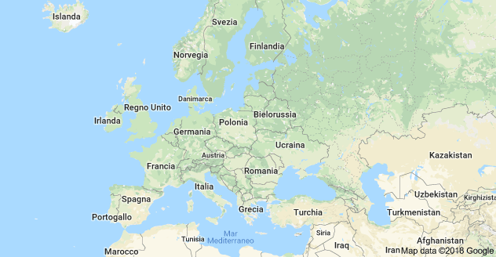
Varese,
Lombardy,
Italy

Slide 3

The Italian context: characteristics of the gambling offer
The process of legalization of gambling, started in Italy since 2003 (through the industrialization of the sector thanks to the concession regime) created a capillary offer
which has indiscriminately reached all citizens in their places of life
both through “physical” gambling (what can be found in bars, tobacconists, slot rooms, betting shops, etc.)
both through “digital” gambling (online, app, etc.).

Slide 4
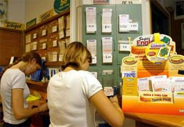
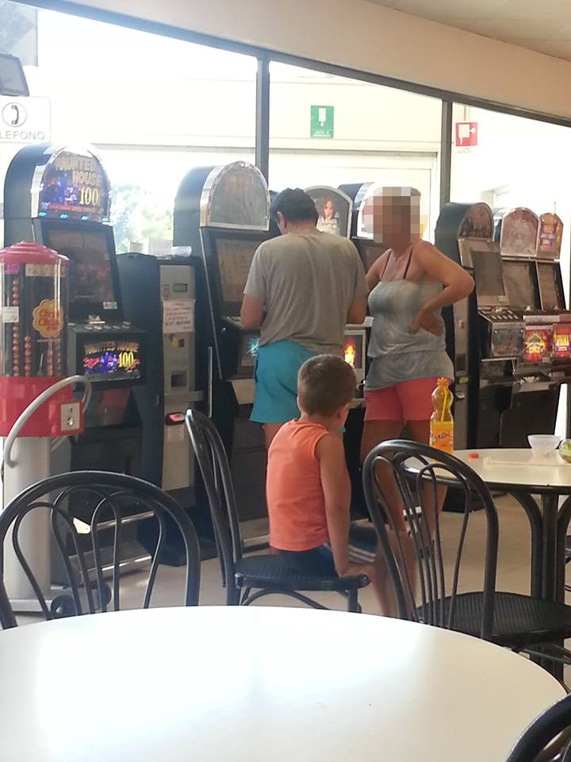
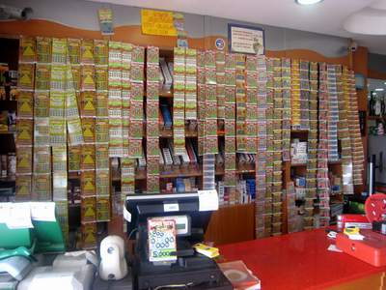
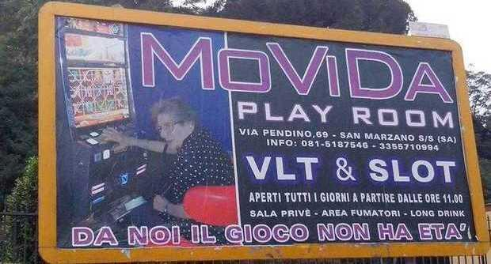
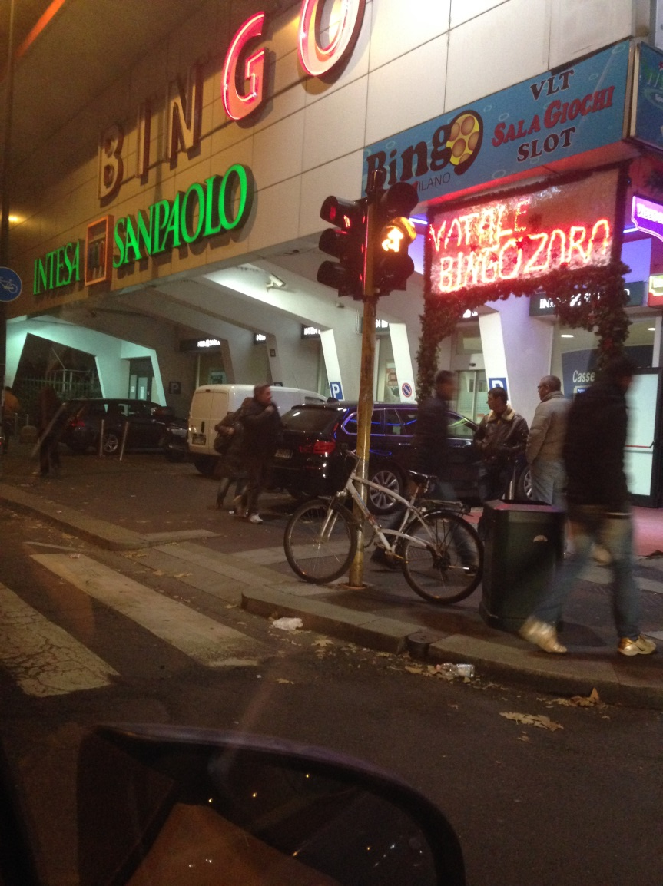
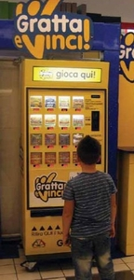
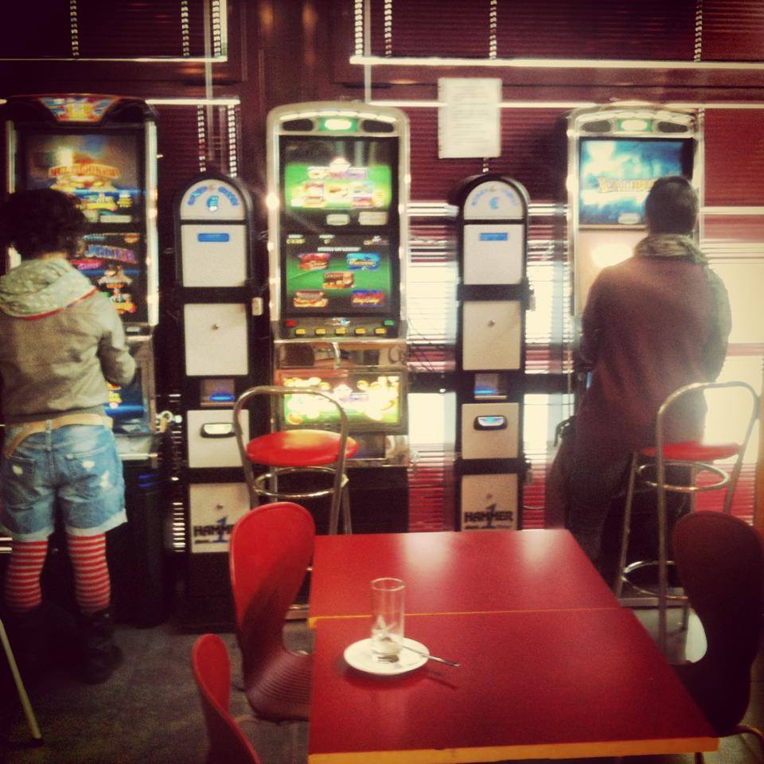
Gambling in Italy
is everywhere

Slide 5

Gambling land based offer
Low threshold – easy accessibility
450.000 Slot machines (80% in coffee bars,
pubs, tobacconist …)
50.000 V.L.T.s (most in gambling venues) – High stakes
Scratch cards - ticket value: 1-20 euros
Lotto (fixed quota drawings) and Superenalotto (variable quota drawings): 3 times per week
Instant Lotto drawings: 1 every 5 minutes
«Ambetto»: Lotto variation based on near misses cognitive distorsion
Win for life (many drawings per day)
Sport, horse and other events betting in corner shops
Bingo
Texas hold ‘em live
3 Casinos - Venice, Saint Vincent, Sanremo (Campione d’Italia)
PLUS: Gambling online (poker cash, poker texas hold ‘em, casino games, bingo, scratch cards….)
1/102

Slide 6


Italy is … 1st in Europe as…
the absolute value of gambling losses
a loss per inhabitant (11% more than the UK, over twice the size of France, Germany and Spain)
gambling losses in proportion to GDP-Gross Domestic Product (1,07 percentage points of GDP)
(Source: The Economist, Sept. 2nd 2015, digital editions, re-elaboration by Paolo Jarre 2018)

Slide 7

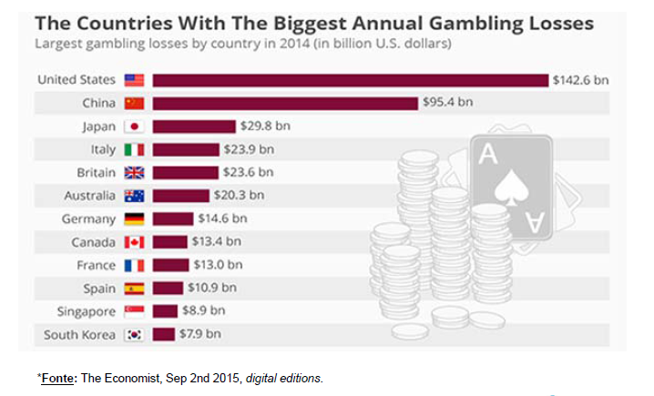
Italy is 4° in the world for Annual Gambling Losses 2014

Slide 8
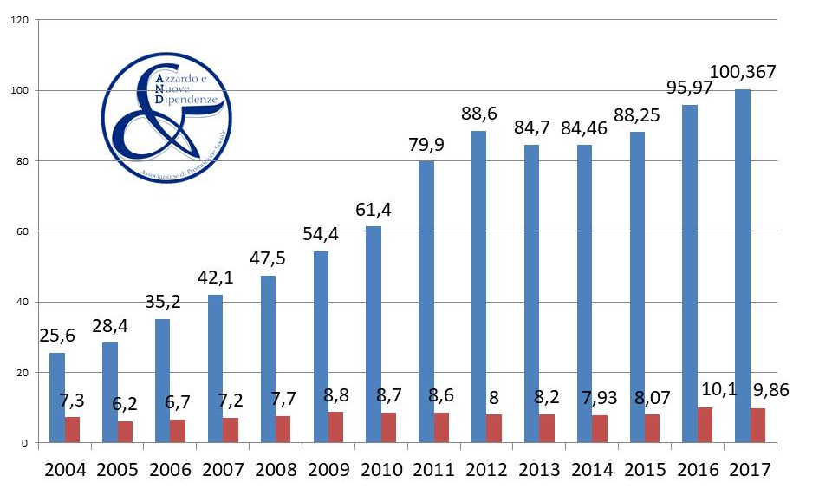
Progressione
Money gambled
(in billions of euros)
Money gambled
Tax revenues

Slide 9
Gambling behavior in Italy
Estimated Italian population gambling
RELAZIONE AL PARLAMENTO SULLE TOSSICODIPENDENZE - 2013
60.418.711 - Total Population
44.248.148 – Population aged 18-74
23.894.000 (54%, 18-74) Gambled at least once in the past 12 months
302.093 – 1.329.211 Pathological Gamblers
(0,5% - 2,2% on Tot Pop;
1,3%-5,6%
on gamblers aged 18-74)

Slide 10

(tot. pop.) | 60.418.711
 | 0,5% | 2,2%
gamblers | 302.093 | 1.329.211
family | 2.114.651 | 9.304.477
Total (G+F) | 2.416.744 | 10.633.688
% on pop | 4% | 17,6%
In Italy, considering 2,2% GD rate,
almost 1 citizen out of 6 «co-exists» -
Directly or indirectly - with harms caused from
gambling disorder: 9 million are relatives!

Slide 11
Gambling and the family
THE FAMILY IS THE 1st VICTIM OF GAMBLING
Stress –Strain - Coping – Support
Gambler
partner
sons and daughters
partents
Other family members

Slide 12
With what the family lives together?
Changes in the gambler’s mood and behavior
Reduction of economic availability
Frequent conflicts and quarrels (also in front of the children)
Decreased quality of life and social closure
Graziano Bellio, 2012

Slide 13
The loss of trust
Traumas to trust are determined by:
  Lies and gambler’s minimizations
  Relapses
  Revelations in stages of the real entity of the economic hole
Without trust there is instability and uncertainty for the present, for the past and for the future
Uncertainty involves a condition of anxiety, fear, chronic stress
Graziano Bellio mod., 2012

Slide 14
Families and
“t” type post-traumatic stress disorders
“t” traumas* are very common experiences in the every day life of gamblers’ family members
They greatly affect their sense of personal value, security, self-esteem and sense of effectiveness.
When we meet the family, exposure to trauma is still ongoing
* repeated experiences of neglect in caring and / or having been exposed to excessive and constant reprimands, or having suffered verbal or physical violence, being bullied, or having been burned by the breakup of an important relationship, having been abandoned, having suffered the sudden loss of economic security, etc.)

Slide 15
Specific treatment of traumatic conditions is necessary
Usually, for traumas with a lowercase “t”, there are no clear memories of specific episodes but only very vague feelings or memories that in the present life can manifest themselves through various general ills such as panic attacks, obsessions, phobias, chronic pains, anxiety, depression, somatization, sense of dissatisfaction, nervousness, internal agitation, easy quarrelsome, constant feeling of never feeling understood, or chronic sensation of loneliness and abandonment, etc.
These are often signs of failure to process disturbing episodes that continue to take place in the present by creating a general uneasiness and/or illness.

Slide 16
Temporal declination of harms
General harms
  Experienced harms at any level of constant and non-occasional gambling
Crisis harms
  Harms related to the period in which help was requested
Legacy harms
  Harms experienced even after cessation of gambling behavior

Slide 17
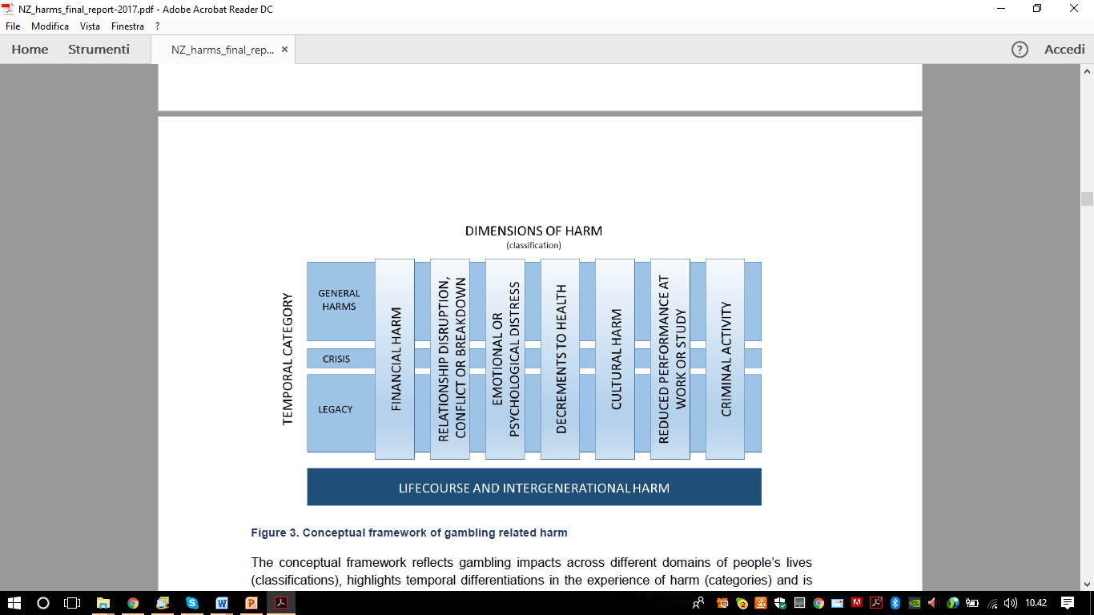
(Langham et al., 2016, in Browne et al. 2017-p.58)

Slide 18
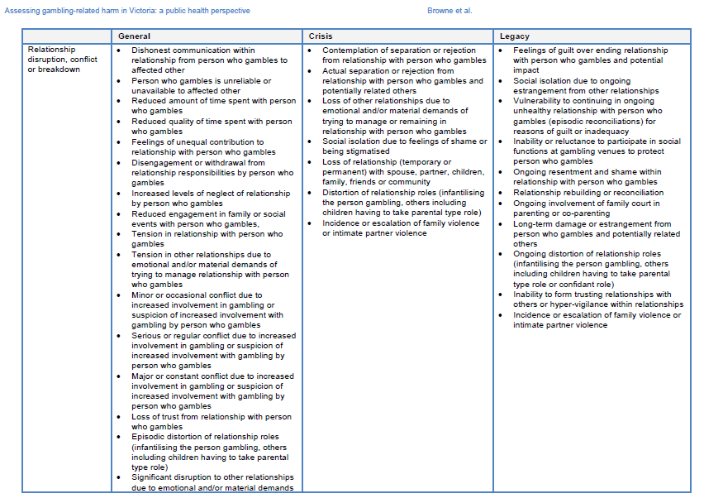
Detailed harm taxonomy, in Browne et al. 2016-p.76

Slide 19
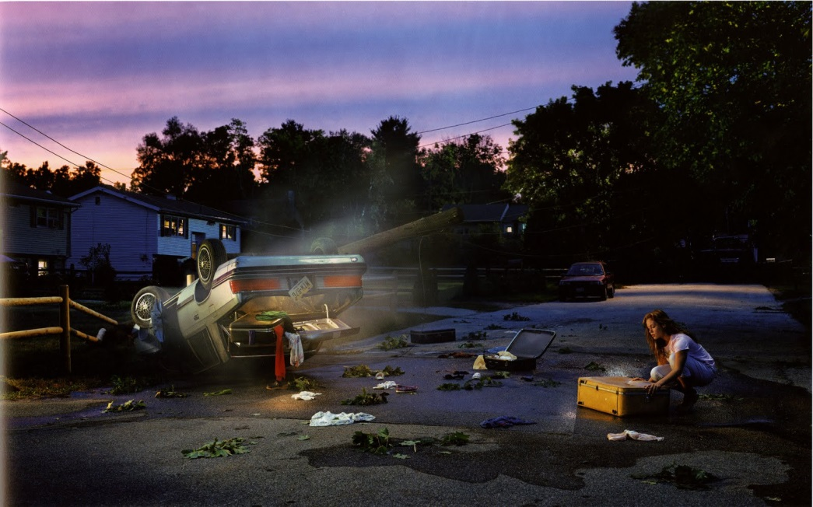
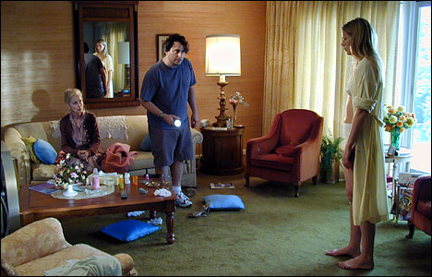
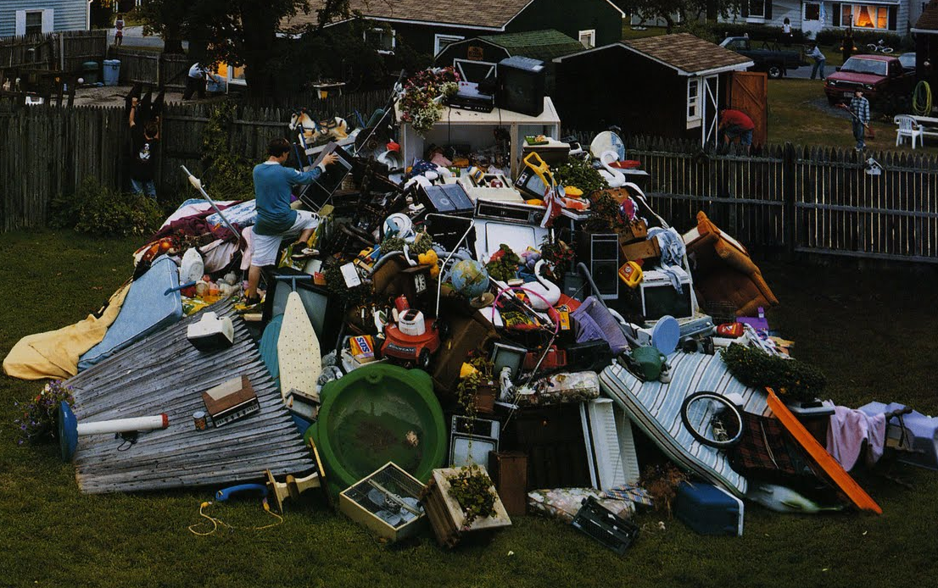
Which model will help
«Gambled Families»?

Slide 20
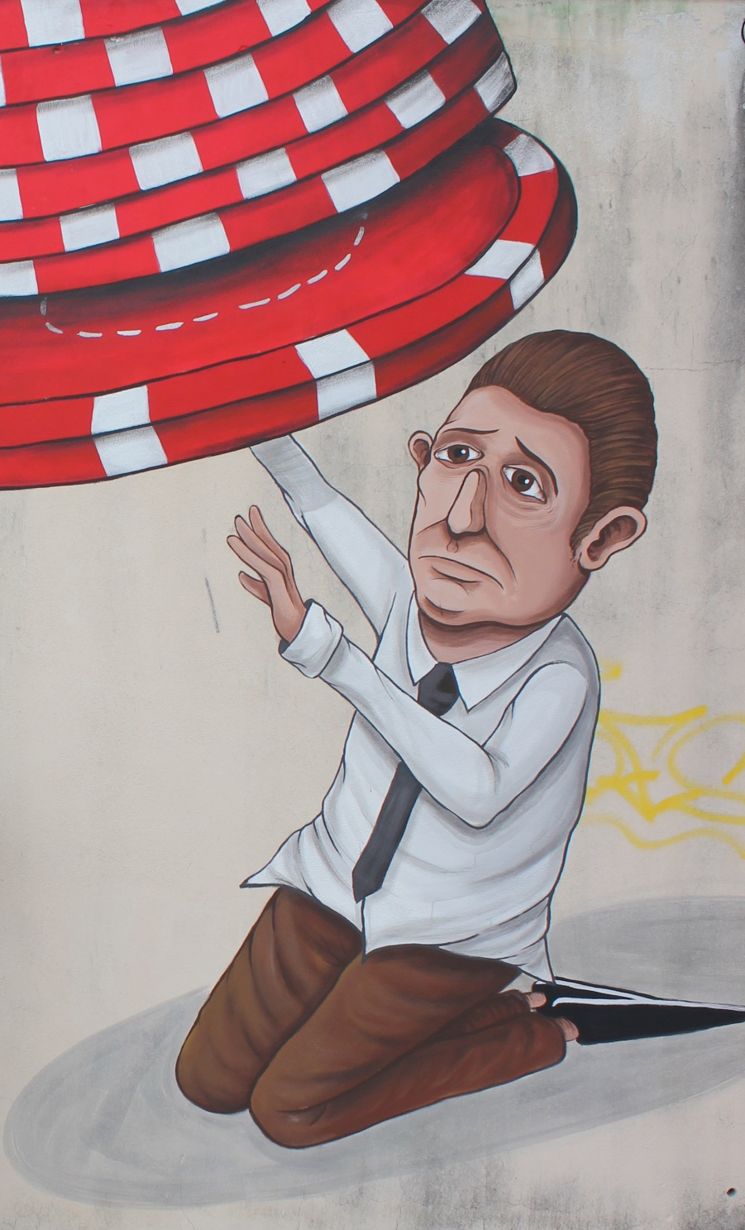
Conflict - Breakdown
Financial Harm
Relationship Disruption
Emotional & psychological Distress
Decrement in health
Reduced performance at work / school
Criminal Activity

Slide 21

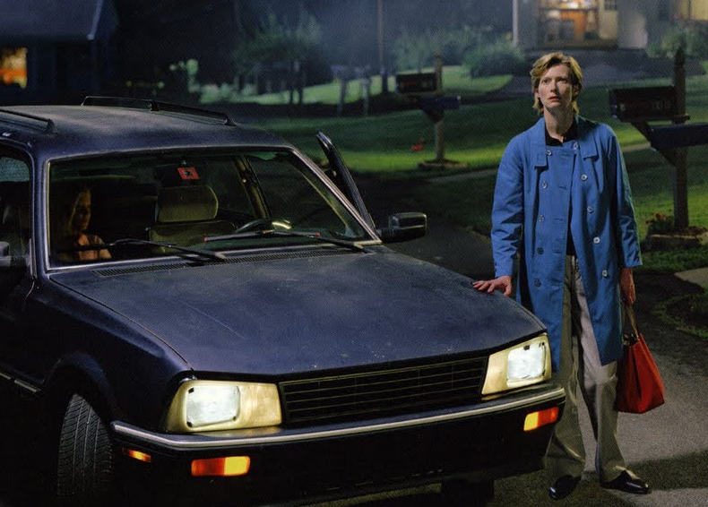
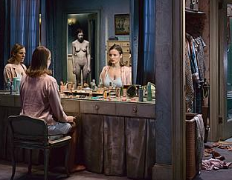
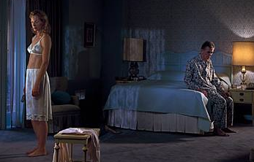
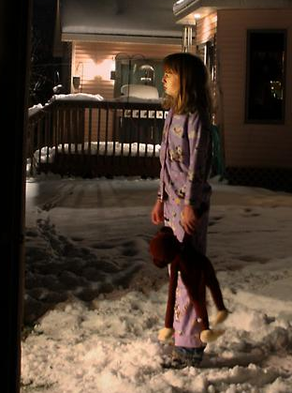
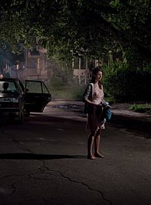

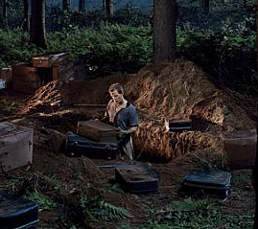
Fragmented and decentralized?
Family Counseling Services
Individual, couple and family Therapy
Psychiatric
Services –
Comorbid
Issues
Addiction
Services –
Gambling
Treatment
Psychological
support to
children
Legal advice –
Harm reduction (AdS)
Divorce, …
Financial advice and debt reconstruction

Slide 22

Integrated and centralized?
Addiction
Services –
Gambling
Treatment
Family Counseling Services
Individual, couple and family Therapy
Psychiatric
Services –
Comorbid
Issues
Psychological
support to
children
Legal advice –
Harm reduction (AdS)
Divorce, …
Financial advice
and debt reconstruction

Slide 23

Three points to support PG families to get out of the labirynth
Consider and treat their discomfort as the most appropriate reaction to the repeated traumas they are suffering every day
Organize around their needs exhaustive and complete support services, adequate to the weights that they are carrying (offering support in all impacted areas, also practical)
Promote cultural change in the community: give voice to their suffering

Slide 24

Thanks for your attention!
Daniela Capitanucci
capitanucci@andinrete.it
www.andinrete.it
https://www.facebook.com/Azzardo.e.Nuove.Dipendenze/

